Slide 1
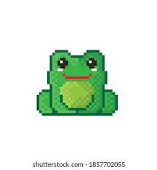
Knit It
A frog catch game

Slide 2
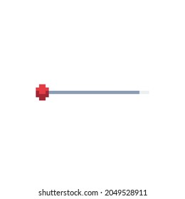

Pitch
Knit It, is a cute simple game that follows a frog as he is trying to knit his jumpers.
The game appeals to all with its cute pixel graphics- help the frog catch his required colours of yarn in order to knit himself a new sweater to keep warm.

